Slide 1
JAVA INSTALLATION
Prepared by
Group -D

Slide 2
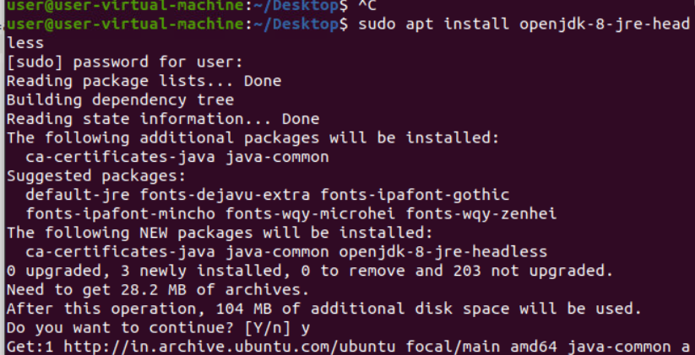
Java Installation
Type sudo apt install openjdk-8-jre-headless

Slide 3
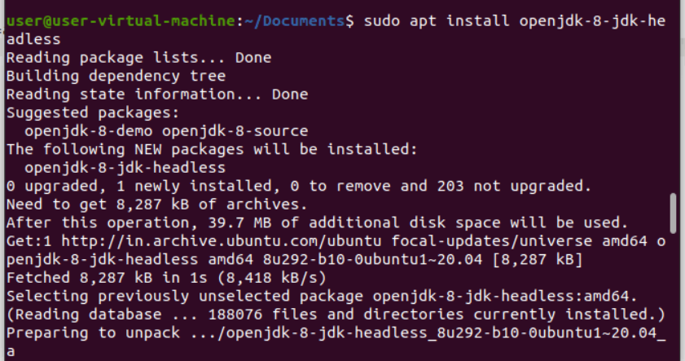
Install JDK
Install packages for java

Slide 4
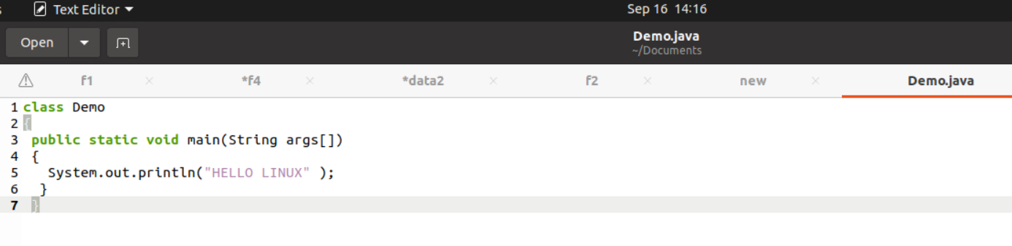
CODE
Write a code and save.

Slide 5
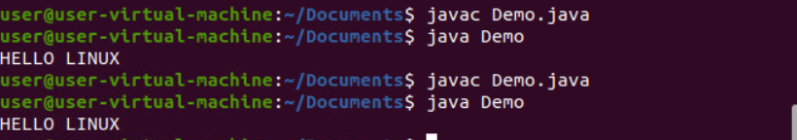
Compile and Execute
Compile– javac filename.java
Run – java filename

